Slide 1
Online Enrollment System – Final Reginald Tremor The University of Arizona Global Campus CST 499: Capstone for Computer Software Technology Charmelia Butler September 7, 2025

Slide 2
Summary of the Software Requirements Specification (SRS)

Slide 3
Purpose and Scope
Outline features, limitations, and objectives of OCRS
Facilitate student secure registration, enrollment, waitlisting and profile management
Built using XAMPP (Apache, MySQL, PHP)

Slide 4



System Overview
Standalone web app doing away with manual registration
XAMPP as a local development environment and scalability to remote hosting
Interfaces: MySQL backend, PHP as logic, and browser front end

Slide 5




Core Features
ID uniqueness will be validated on registration
User login/logout that is secure
User can manage their courses
Courses are offered each semester
Enrollment limits and waitlist logic

Slide 6

External Interfaces
User Interface: responsive, intuitive, and functional across browsers
Software Interface:
Apache (HTTP)
PHP (server-side logic)
MySQL (data)

Slide 7
UML Designs

Slide 8
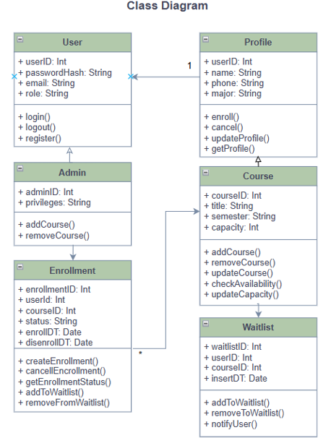
Class Diagram
A Class Diagram will help document the structural design of the Online Course Registration System
Notes:
Overview: Here we have a UML class diagram that represents the dominant objects and associations in a course enrollment system. I utilized object-oriented design principles to represent class responsibilities, attributes, and methods. Concepts to examine are encapsulation, modularity, and association.
User & Profile: The User class manages authentication and registration, while the Profile stores personal information. Their association is one-to-one, allowing for separation of concerns and for maintainability.
Admin & Course: Admin has a dependency relationship on Course. The Admin methods: addCourse() and removeCourse() are examples of role-based access control. The Course class encapsulates course data and allows for updates.
Enrollment & Waitlist: Enrollment is where User and Course associate. Enrollment tracks user course status, as well as timestamps using the enrollment methodology. The Waitlist class captures overflow event usage that includes the attributes waitlistDate and the methods for user notification.
Relationships & Design Logic: The associations and dependencies show the flow in the system. Each class was designed with single responsibility in mind as the basis of cohesion within the classes. Each of the classes has been designed to be scalable and not limit the possibility of future system integration

Slide 9
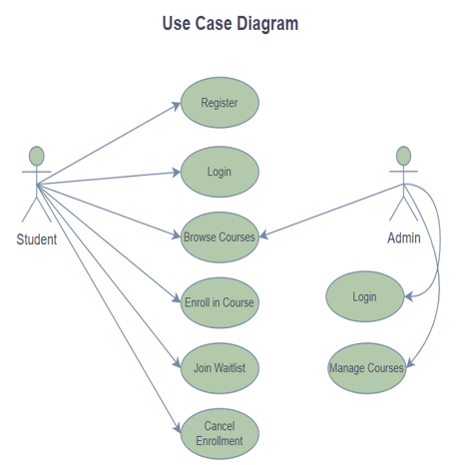
Use Case Diagram
Help illustrate how different users interact with core functions
Notes:
Student actor: Will engage in six core functions: Register, Login, Browse Courses, Enroll, Waitlist, and Cancel Enrollment. These use cases indicate what a normal user would do and allow us to confirm the system supports for full enrollment cycle. Each use case reflects a single interaction and follows the notion of functional decomposition.
Admin: The Admin actor will interact with Login and Manage Courses. Though limited in functional acts, it is certainly a high-impact access. This demonstrates role-based control. The Admin is responsible for keeping course offerings and the information in the system fresh in accordance with the academic terms.

Slide 10
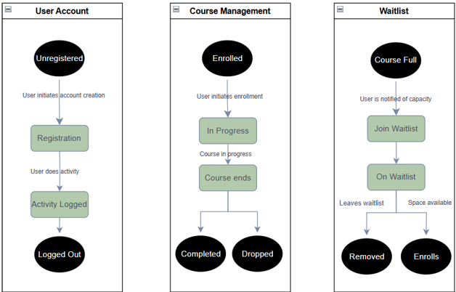
State Diagram
Illustrates the different states that objects go through, this is helpful to visualize the life-cycle of key Objects
Notes:
User Account Flow:
When we begin to look at User Account flow, we begin with the unregistered state. After the user initiates their registration, they will move into an 'Active' state and we are recording their activity. Eventually, we will exit the user's account, the user is then in the 'Logged Out' state. Taking these sequences into consideration is important as it represents basic session management, along with understanding the user lifecycle.
Course Management Flow:
The Course Management flow starts with enrollment. After the user moves into an 'In Progress' state, there is a checkpoint - has the course ended? Based upon this outcome, you will exit the other two states of 'Completed' or 'Dropped.' This models conditional logic and outcome based transitions.
Waitlist Flow:
When the course is full, the user is brought into this waitlist flow - they are given notification and can either join the waitlist or not. Following this, they can be either removed from the waitlist or enrolled if a spot opens up. This section allows us to show event based transitions and system responsiveness.

Slide 11
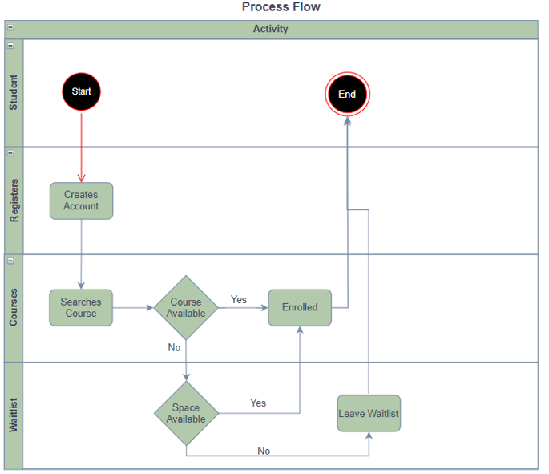
Activity Diagram
Aids in visualizing the workflow of key process
Notes:
Student Actions:
The process starts with the student creating a profile and searching for a course. The events of these actions initiate the workflow and the control of the process is transferred/engaged from the Student lane, to the course management logic lane. The Student lane illustrates an event driven action by a user and determines the incoming user-driven workflow for the system responses.
Course Availability Decision:
Once a specific course is selected by the course management logic, the system checks for availability for spots in the course/event. If there is availability for seats, the student is enrolled and the workflow ends. If there are not seats open, the control is transferred to the wait-list lane. This decision point is modelled and determines the logic in case only some of the seats are filled. This condition is in place for the capacity of the system to respond on the flow from the decision node.
Waitlist Handling:
In the waitlist lane, the system checks to see if there is availability for the space. If the allocation logic finds any, then the student is offered the opportunity to enroll into the course/event. If no availability is found, the student is removed from waitlist enrollment and the workflow ends

Slide 12
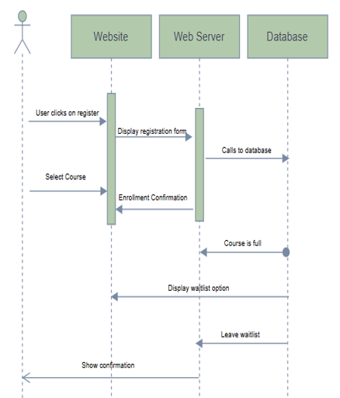
Sequence Diagram
Illustrates the step-by-step interaction of the users to the system, showing flow of requests and responses.
Notes:
User interaction: The user clicks 'Register' and the webpage returns the registration form. The user indicates a course and the webpage sends a request to the webserver to enroll the course. This is an example of synchronous communication and events caused by the user.
Server & Database Logic: The web server attempts to process the request and queries the database. If the course is full, the database responds with a no-availability message. This is an example of conditional logic and system feedback triggering a waitlist option.
Waitlist Decision: The user has the choice to leave the waitlist, which the webpage acknowledges. This is a complete circle for the final interaction of the user and the website with an acknowledgment of real-time response. Each message in the diagram represents a method call in an object-oriented programming language or system response based upon an event, and follows UML sequence modeling.

Slide 13
MYSQL Tables

Slide 14
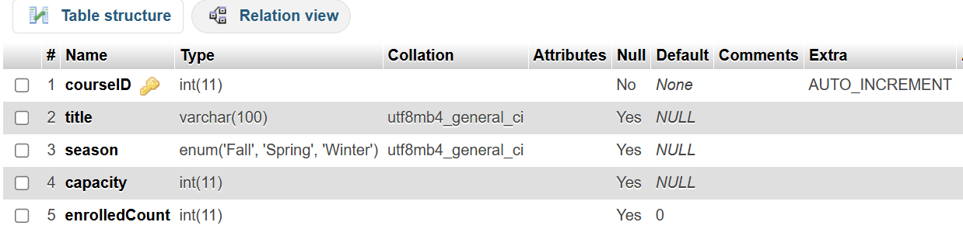
Courses Table
-- COURSES TABLE
create table Courses (
courseID INT AUTO_INCREMENT PRIMARY KEY,
title VARCHAR(100),
trimester ENUM('Fall', 'Spring', 'Summer'),
capacity INT,
enrolledCount INT DEFAULT 0
);
Designed to manage course including course title, trimester, capacity and how many students have enrolled
Notes:
Primary Key:
courseID is our primary key column. It is an INT and marked with AUTOINCREMENT. This ensures that each course has a primary key with unique identification. This design also enables efficient indexing as well as relational joins with other tables such as Enrollment or Waitlist.
Capacity & Enrollment Tracking: capacity and enrolledCount are INT columns. They describe how many students can enroll in a course, and how many students are currently enrolled in a course. They will therefore enable queries that can run checks that will indicate whether a course is available for enrollment or a waitlist.

Slide 15
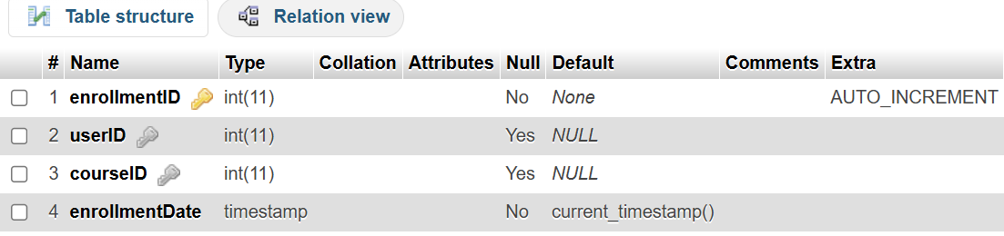
Enrollment Table
-- ENROLLMENTS TABLE
create table Enrollments (
enrollmentID INT AUTO_INCREMENT PRIMARY KEY,
userID INT,
courseID INT,
enrollmentDate TIMESTAMP DEFAULT CURRENT_TIMESTAMP,
FOREIGN KEY (userID) REFERENCES Users(userID),
FOREIGN KEY (courseID) REFERENCES Courses(courseID)
);
Designed to manage enrollment of users to courses, including user and course ID and date added
Notes:
This table stores student enrollments in courses. It's a junction table to connect users and courses together to track registration. Each row is a unique enrollment.
Primary Key & Identity: enrollmentID is the primary key. It's an INT with AUTOINCREMENT, which keeps track of records to make sure each enrollment is unique. This allows for an index and efficient way to JOIN to related tables such as users and courses.
Foreign Keys: userID and courseID are both INT fields that reference the users table and the courses table, respectively. Here they are nullable to allow use during testing or staging of data entry. In production, we will utilize foreign key constraints to ensure referential integrity.

Slide 16
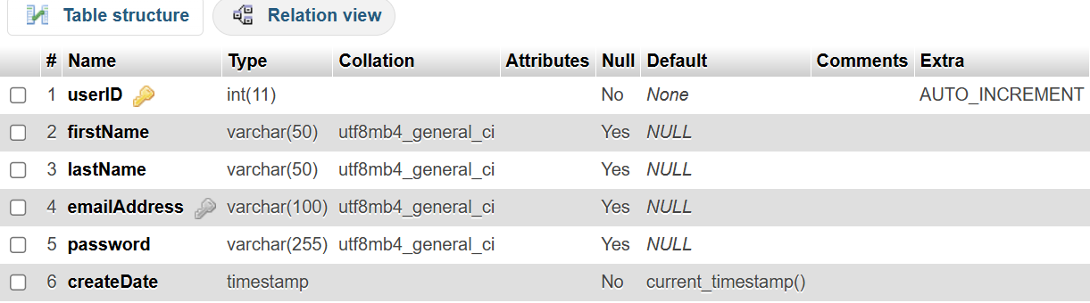
Users Table
-- USERS TABLE
create table Users (
userID INT AUTO_INCREMENT PRIMARY KEY,
firstName VARCHAR(50),
lastName VARCHAR(50),
emailAddress VARCHAR(100) UNIQUE,
passwordHash VARCHAR(255),
createDate TIMESTAMP DEFAULT CURRENT_TIMESTAMP
);
Designed to manage user data, including names, email addresses, account creation date etc.
Notes:
userID: This refers to that which is unique for every user. The value is an INT with AUTOINCREMENT to ensure that every user has their own unique key. This is useful for the database indexing and identifying joinable relationships with others. In this instance, to tables like Enrollment and Profile.
Personal Information: firstName, lastName, emailAddress are all VARCHAR with a maximum length. These fields are nullable so there is some flexibility when using during account creation or doing partial registration.
Password & Security: password is a VARCHAR(255). This allows it to store hashed values, in order to use secure hashing algorithms (like bcrypt).

Slide 17
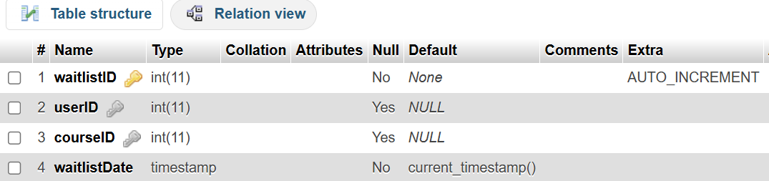
Waitlist Table
-- WAITLIST TABLE
create table Waitlist (
waitlistID INT AUTO_INCREMENT PRIMARY KEY,
userID INT,
courseID INT,
waitlistDate TIMESTAMP DEFAULT CURRENT_TIMESTAMP,
FOREIGN KEY (userID) REFERENCES Users(userID),
FOREIGN KEY (courseID) REFERENCES Courses(courseID)
);
Designed to manage waitlist for courses, including user and course ID and date added to waitlist
Notes:
Primary Key: waitlistID is the primary key, set to AUTOINCREMENT and an INT, guaranteeing unique identification to each waitlist entry. Having a unique identifier for every waitlist entry will allow a fast visualization of where users are in the process of being waitlisted and prioritizing lists on a unique basis.
Foreign Keys: userID and courseID are both INT fields that refer to both the respective user and course tables. These relationships will allow the system to reference waitlisted users to each course once there is an available position and facilitate enrollment.

Slide 18
PHP Pages

Slide 19
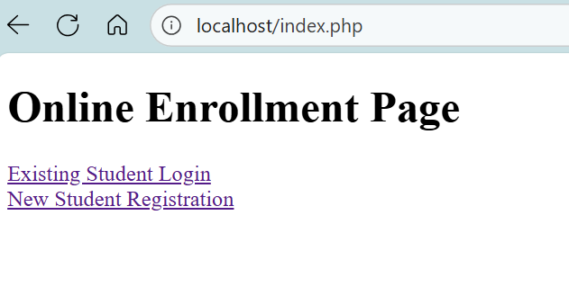
Landing Page (index.php)
Landing page allows student to login into existing account, or register as new student
Notes:
The HTML landing page functions as the client-side entry point of the course enrollment system. The landing page uses anchor tags sending the user to login.php and register.php to start the authentication and registration workflows, respectively. The page has a clean layout and an easy usability pattern with access to all the backend functionality.

Slide 20
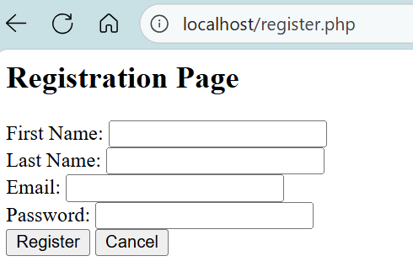
Register Page (register.php)
A new student is required to fill out key account information to register
Notes:
The register.php script will manage the new user registration process of form data gathering, password hashing, and inserting the user in the Users table using a prepared SQL statement. The script starts a session, stores the new userID, and then, if successful, directs to profile.php. Core functions include sessionstart(), passwordhash(), and mysqli::prepare().

Slide 21
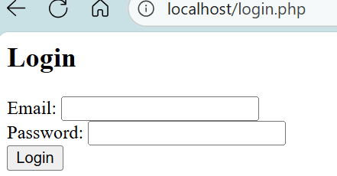
Login Page (login.php)
A returning student must login to manage their courses
Notes:
This page manages user authentication using mysqli::prepare() and passwordverify() credential checking against the database. If successful the script will then start a session with $SESSION['userID'] and redirect to profile.php. Its core functionality is to provide secure login, manage sessions, and conditionally handle errors. Core functionality is then to provide secure login, manage sessions, and conditionally handle errors.

Slide 22
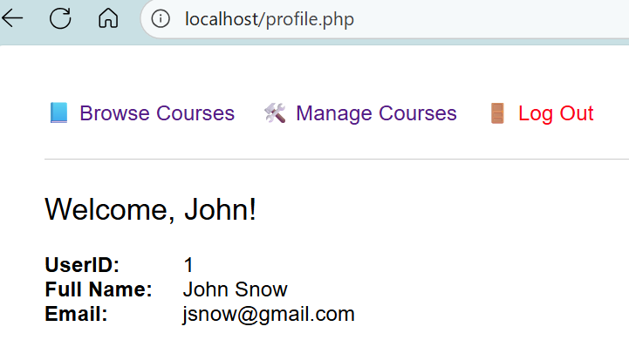
Profile Page (profile.php)
On the profile page, the student can manage enrolled courses, browse courses, and logout
Notes:
This page displays user profile data after confirming session access with $SESSION['userID']. It uses mysqli::prepare() to securely retrieve user details and htmlspecialchars() to prevent XSS. The navigation links for page provided course browsing, management, and logout options.

Slide 23
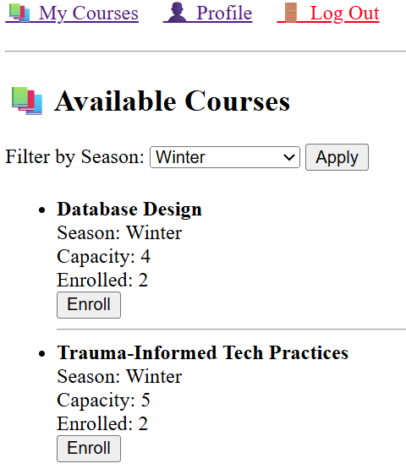
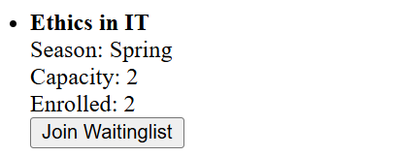
Browse Courses Page (courses.php)
Allows one to browse courses and filter by season
Each course will display its capacity and number of students enrolled
Ability for students to register or to be waitlisted
Notes:
This page displays available courses. The user can filter seasons (optional) using $GET and dynamic SQL.
This page checks for current enrollments via mysqli::prepare() and whether that capacity is still full, using a conditional to render either the enroll or waitlist button.

Slide 24
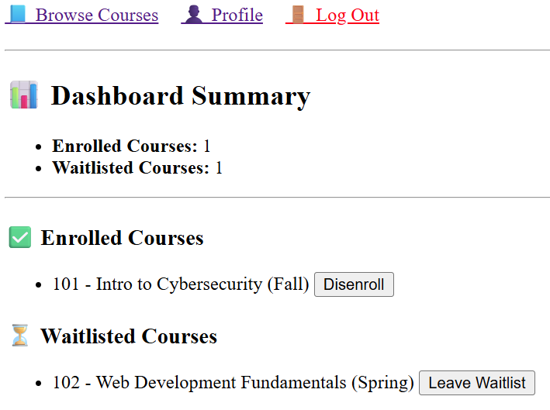
Manage Courses Page (mycourses.php)
Outlines a summary of how many courses/waitlisted that student has been enrolled
Ability for student to disenroll or leave waitlist
Notes:
The dashboard shows a user’s courses that they are enrolled in, and the courses they are placed on a waitlist for using JOIN queries and the COUNT() function for summary totals, all managed by using $SESSION['userID'], and each output is secured using htmlspecialchars().
Each course entry has logic that conditionally displays a "Disenroll" or "Leave Waitlist" button that will execute a DELETE statement to remove the use's record from the specified table. As a complete set of functions, the dashboard allows for real-time use of courses and user-enrollments.

Slide 25
Online Course Enrollment System - Demo

Slide 26
References

Slide 27
McConnell, S. (2004). Code Complete: A Practical Handbook of Software Construction (2nd
ed.). Microsoft Press. https://archive.org/details/code-complete-2nd-edition/mode/2up
Sommerville, I. (2015). Software engineering (10th ed.). Pearson Education.
Software Engineering, 10th GLOBAL Edition
Tsui, F., Karam, O., & Bernal, B. (2018). Essentials of software engineering (4th ed.). Jones &
Bartlett Learning.
Khleel, N. A. A., & Nehéz, K. (2022). Comparison of version control system tools. University of
Miskolc. https://real.mtak.hu/164521/1/441_doi.pdf
Koc, A., & Tansel, A. U. (2011). A survey of version control systems. International Conference
on Software Engineering and Management. https://www.iiis.org/cds2011/cd2011imc/iceme_2011/paperspdf/fb394vz.pdf
Maashi, M. S. (2022). A comprehensive review of software testing methodologies based on
search-based software engineering. Webology, 19(1), 51. 20220203075100pmwebology 19 (1) - 51.pdf
Myers, G. J., Badgett, C., & Sanders, T. (2011). The art of software testing (3rd ed.). Wiley.
https://onlinelibrary.wiley.com/doi/book/10.1002/9781119202486?msockid=1643d618d6636b042035c3a5d7e06af6

Slide 28
Bertolino, A. (2007). Software testing research: Achievements, challenges, dreams. Future of
Software Engineering (FOSE '07), 85–103. https://doi.org/10.1109/FOSE.2007.25
Garousi, V., Felderer, M., Kuhrmann, M., Herkiloglu, K., & Eldh, S. (2020). Exploring the
industry's challenges in software testing: An empirical study. Journal of Software: Evolution and Process. https://doi.org/10.1002/smr.2251
Kazman, R., Klein, M., & Clements, P. (2000). Evaluating software architectures: Methods and
case studies. Addison-Wesley. https://www.scribd.com/document/836369482/2012-Evaluating-Software-Architectures-Methods-and-Case-Studies-Klein-Mark-Kazman-Rick-Clements-Paul
Bass, L., Clements, P., & Kazman, R. (2012). Software architecture in practice (3rd ed.).
Addison-Wesley.
Wiegers, K. E. (2003). Software requirements (2nd ed.). Microsoft Press.
Software requirements : practical techniques for gathering and managing requirements throughout the product development cycle : Wiegers, Karl Eugene, 1953- : Free Download, Borrow, and Streaming : Internet Archive
OWASP Foundation. (2022). OWASP top ten web application security risks.
https://owasp.org/www-project-top-ten/
Nielsen, J. (1994). Usability engineering. Morgan Kaufmann.
Usability Engineering: | Guide books | ACM Digital Library

